Slide 1
BRAND MANUAL
Israk Solutions Sdn. Bhd.
MOST TRUSTED BRAND

Slide 2
BRAND
VISION AND MISSION
To become the leading provider of innovative audio-visual solutions, enhancing communication and collaboration for businesses and institutions worldwide.
We are committed to delivering cutting-edge audio-visual technology and exceptional service to empower our clients with seamless communication, engaging presentations, and collaborative solutions. We aspire to foster technological advancement while providing top-notch customer experiences
MOST TRUSTED BRAND

Slide 3
BRAND
GOALS
Market Leadership
Achieve and maintain a leadership position in the audio-visual industry by 2024
Customer Satisfaction
Ensure a high level of customer satisfaction by consistently exceeding expectations and providing excellent support.
Innovation
Continuously innovate and adapt to emerging technology trends, keeping ARVIA at the forefront of the industry.
Global Expansion
Expand our market presence beyond Malaysia and establish a global footprint.
MOST TRUSTED BRAND

Slide 4
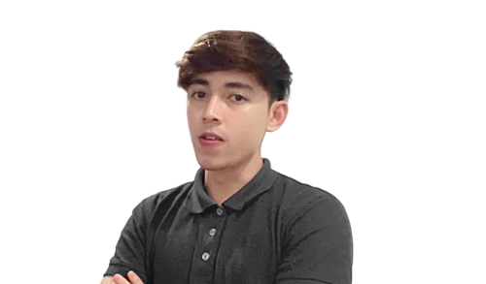
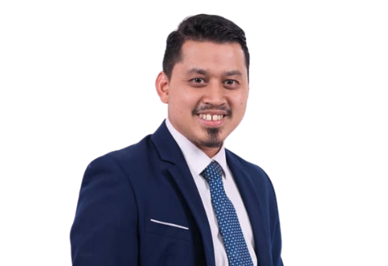
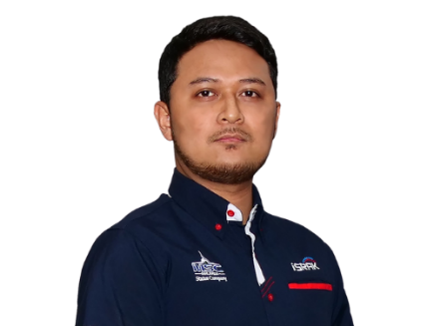
BRAND COMMITTEE
Organizational Chart
BRAND MANAGER
NADIAH HASHIM
Leads Brand Strategy, Promotion, Advertising, and Positioning
DIGITAL MARKETING
BUSINESS DEVELOPMENT
DATA ANALYST
NUR HAFIZ
RUZILAH
ROZIYANA
SITI AISHAH
IKRAM
MOHD SYAFEE
Engineer
Manages Digital Marketing, Focusing on Online Brand Activities.
Executes Brand Marketing Campaigns, to Ensure Brand Consistency
Client Acquisition, Explores Market Opportunities, Leads Sales Initiatives.
Client Acquisition, Explores Market Opportunities, Leads Sales Initiatives.
Analyzing Data Related to Brand Performance and Customer Feedback.
Analyzing Data Related to Brand Performance and Customer Feedback.
MOST TRUSTED BRAND

Slide 5
BRAND
IDENTITY
Name: ARVIA (Derived from the Latin word, meaning 'view beyond anything' or 'foresighted.'
Logo: The ARVIA logo is represented in blue, symbolizing trust, reliability, and professionalism. The logo consists of the brand name "ARVIA" in a distinctive font, creating a strong and memorable visual identity.
Tagline: "Innovating AV Excellence" - a commitment to advancing and enhancing Audio-Visual (AV) experiences through continuous innovation. It conveys a dedication to pushing the boundaries of excellence in AV technology, services, or solutions.
Colors: Blue (as the primary brand color), and additional colors as needed for design and branding.
Color Code - red : #DF1F26
- dark blue : #181F34
- white : #ECF1FA
MOST TRUSTED BRAND

Slide 6
BRAND
REGISTERED IN MALAYSIA
Brand Registered in Malaysia
Trademark Usage:
The ARVIA brand is registered as a trademark in Malaysia.
We always use the ® symbol next to the ARVIA logo to indicate its registered status in our presentation, report and corporate document
MOST TRUSTED BRAND

Slide 7
BRAND
IMAGERY
Consider creating a visual style that aligns with the brand's identity. Given that ARVIA is about innovation and foresight, imagery should reflect a sense of advancement and forward-thinking. Here's a sample imagery section:
Photography Style:
Use high-quality, professional images that convey a sense of modernity and innovation.
Showcase diverse scenarios where ARVIA products are utilized, such as in corporate settings, education environments, and collaborative workspaces
Color Palette:
Ensure that images align with the brand's color palette, emphasizing the primary blue and any additional colors specified in our brand manual
Iconography:
Develop a set of icons that can be consistently used in presentations, marketing materials, and on the website. These icons should represent key features or benefits of ARVIA products
Consistency:
Maintain a consistent visual style across all imagery, reinforcing the brand's professionalism and commitment to innovation
MOST TRUSTED BRAND

Slide 8
BRAND
STORY
ARVIA, derived from the Latin word, means 'view beyond anything' or 'foresighted.' This name reflects our commitment to innovation and a forward-thinking approach in providing audio-visual solutions
Our journey is marked by a dedication to delivering cutting-edge technology and exceptional service, ensuring our clients experience the future of communication and collaboration
BRAND PROMISE
BRAND POSITIONING
At ARVIA, our promise is to consistently exceed your expectations with innovative audio-visual solutions. Drawing inspiration from our name, meaning 'view beyond anything' or 'foresighted,' we are dedicated to delivering exceptional quality, technology, and customer service to enhance our communication and collaboration experiences
ARVIA positions itself as a trusted leader in the audio-visual industry, delivering innovative solutions that enhance communication and collaboration on a global scale. The brand name, derived from Latin, emphasizes a forward-thinking and visionary approach

Slide 9
CORPORATE IDENTITY
Letterheads:
Logo Placement:
The ARVIA logo should be prominently placed at the top or bottom of the letterhead, maintaining a clear margin from the edges
Email Signatures:
Basic elements:
Include the ARVIA logo
Full name, job title, and contact information (phone number, email, and office address)
MOST TRUSTED BRAND

Slide 10
BUSINESS CARD
Logo Placement:
The ARVIA logo should be prominently placed on the front side of the business card.
Color Usage:
Use the full-color logo on a clean, white background for a professional look.
Typography:
The primary font should be used for the name and job title on the business card.
Imagery:
The back of the business card may include a small visual element or icon that aligns with the brand.
MOST TRUSTED BRAND

Slide 11
BUY-IN ACTIVITIES
Building a strong brand culture and aligning employees requires intentional activities that foster a sense of belonging, shared values, and a commitment to the organization's mission
Brand Workshops and Training Sessions
Brand Immersion Day
Cross-Departmental Collaboration
MOST TRUSTED BRAND

Slide 12
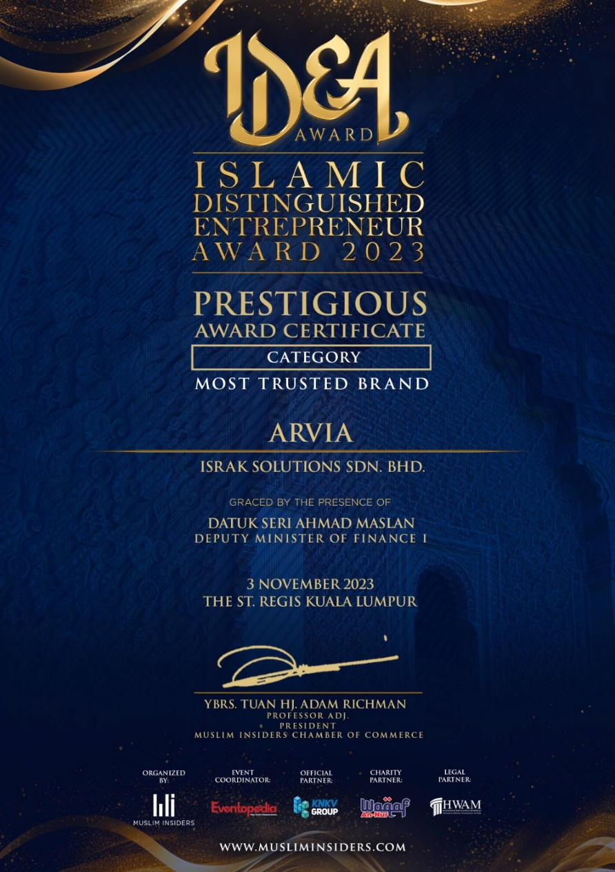
BRAND AWARD
We are honored to announce that we have been bestowed with the prestigious "Most Trusted Brand” in Islamic Distinguished Entrepreneur Award for 2023 and
“Bumiputera BestBrands” in The BrandLaureate Brand of the Year Award 2023"

Slide 13
2024 AWARD PARTICIPATION LIST
Malaysia Technology Award
Malaysia Book of Record
Top Tech Innovation Award
SME Entrepreneurs
Business Awards (SEBA)
MOST TRUSTED BRAND

Slide 14
THANK YOU
www.israk.my

